Slide 1


Public Employees Insurance Program (PEIP)
Introduction and Summary of Benefits for PEIP – 2023 Renewal

Slide 2
1/1/23 RENEWALS
The renewal rates for January 2023 will be based on a combination of the group’s claims and the overall pool. Group’s credibility is based on enrollment size.
2023 clinic directory will be available 10.15.22 at www.innovomn.com. Please check to see if your clinic has changed.
Innovo Benefits Administration is excited to have the PEIP Online Enrollment Portal available for open enrollment. The Online Enrollment Portal can be accessed at https://www.mnpeip.com. Please consult with your HR/Benefits Office prior to submitting changes online.
No member action required unless you are changing Networks (BC/HP/P1), or changing plan designs (High/Value/HSA). If you are just changing clinic assignment that can only be done by calling the phone number on your medical ID card.

Slide 3
Plan Changes for 2023
The only plan change for 2023 is to increase the deductible on the HSA cost level 1 plan to $3,000 per family member/$3,200 per family (This is an IRS mandated change).

Slide 4
Public Employees Insurance Program (PEIP) & Innovo
The Public Employee Insurance Program (PEIP) is a state of Minnesota health plan available to cities, counties and school districts. PEIP is able to leverage off the state employee plan and use the negotiating clout of their size to offer very low administrative costs and multiple network carriers to our member groups.
Deloitte, the world’s largest professional services organization, handles the financials, underwriting, and consulting.
Innovo Benefits is the third party administrator for the PEIP program. Our core staff has worked with the PEIP program since it was created.
Our strength is vast experience and dedication to servicing the PEIP program. Our 30 years of experience has proven to be vital in dealing with the myriad of issues that arise in servicing our employers and members.
The PEIP pool has grown to approximately 385 employer groups covering 45,000 members.

Slide 5
Overview of PEIP Coverage
Members have the choice of three plan design options and three network carriers.
Primary Care Clinic model where clinics are broken down into 4 tiers or cost levels (CL).
Each family member can choose their own primary care clinic (PCC) and your benefit level is based on the cost level of your PCC choice. More efficient, lower cost clinics provide the highest benefit levels.
Generally, all routine and non-emergency care flows through your primary care, referrals are typically required for care outside your PCC.
Prescription drugs are through the CVS Caremark network for all three network carriers.
CVS Caremark has a huge network of pharmacies throughout the state/country.
  You do not have to use a CVS Retail pharmacy.

Slide 6
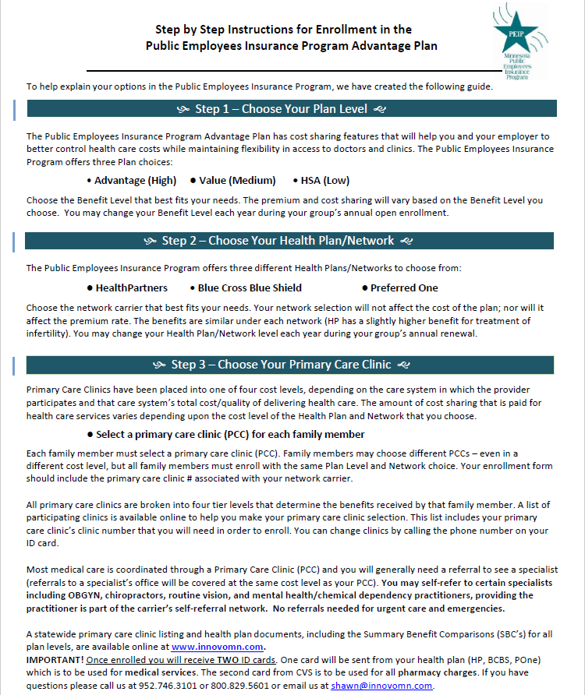
Step by Step Instructions will guide
You through the enrollment steps and provide information you need to make election choices.
Step 1 – Choose Your Plan Level
Advantage High is the highest level of benefits and the highest payroll deduction.
Value is a mid-rage option with a little higher deductible and out of pocket expenses but lower payroll deduction.
HSA option has highest deductible and out of pocket expenses and the lowest payroll deduction.
One plan is selected for employee + 1 and family coverage.
You can change your plan level each year during open enrollment.

Slide 7
Step 2 – Choose Your Health Plan/
Network
HealthPartners
Blue Cross Blue Shield
PreferredOne
Network selection does not affect the cost of the plan or your premium rate.
All three Networks have the same plan design levels. Exception: HealthPartners includes certain treatments for infertility.
One network is selected for employee + 1 and family coverage.
You can change your network each year during open enrollment.

Slide 8
Step 3 – Choose Your Primary
Care Clinic
Primary Care Clinics (PCC) are placed in four cost levels, based on the care system and overall cost/quality of their delivery of care.
Your final benefit level is based on the on the cost level of the primary clinic you choose related to your Health Plan and Network choice.
You will choose a primary care clinic (PCC) for each family member.
PCC does not need to be the same for each family member, nor the same Cost Level.
PCC can be changed monthly by calling your network carrier customer service number on the back of your ID card.
2023 clinic directory available at www.innovomn.com.

Slide 9
Specialists
Referrals to specialists are covered at the same cost level as your PCC.
Members can Self-Refer* to specialists for OBGyn, Mental Health, Chemical Dependency, Chiropractic Care and Routine Vision.
*Practitioners must participate in your network carrier’s self-referral network.
No referrals are needed for Urgent Care or Emergency Services.
CVS Caremark (PBM)
CVS Caremark is the pharmacy benefit manager for PEIP and provides services for all three networks.
Has a nationwide network of more than 68,000 participating retail pharmacies.
PEIP includes both CVS and non-CVS pharmacies. Pharmacy locator tool at www.innovomn.com
Convenient access to retail, specialty services and mail order delivery options.

Slide 10
PEIP Plan Documents and Information
Once enrolled, you will receive two ID cards.
1) One ID card is for medical and will come from your network choice (HP, BC, P1).
2) The second ID card is for all pharmacy services and will come from CVS Caremark.
All PEIP plan documents and tools
are posted on the PEIP website at
www.innovomn.com.
The website includes Plan Summaries and
Plan Documents, Statewide Clinic Directory, Summary Benefit Comparisons (SBC’s), Pharmacy Tools and informative Q&A.
PEIP Customer Service is available from:
7:30am to 4:30pm
952-746-3101
800-829-5601
Or email your question to
service@innovomn.com

Slide 11
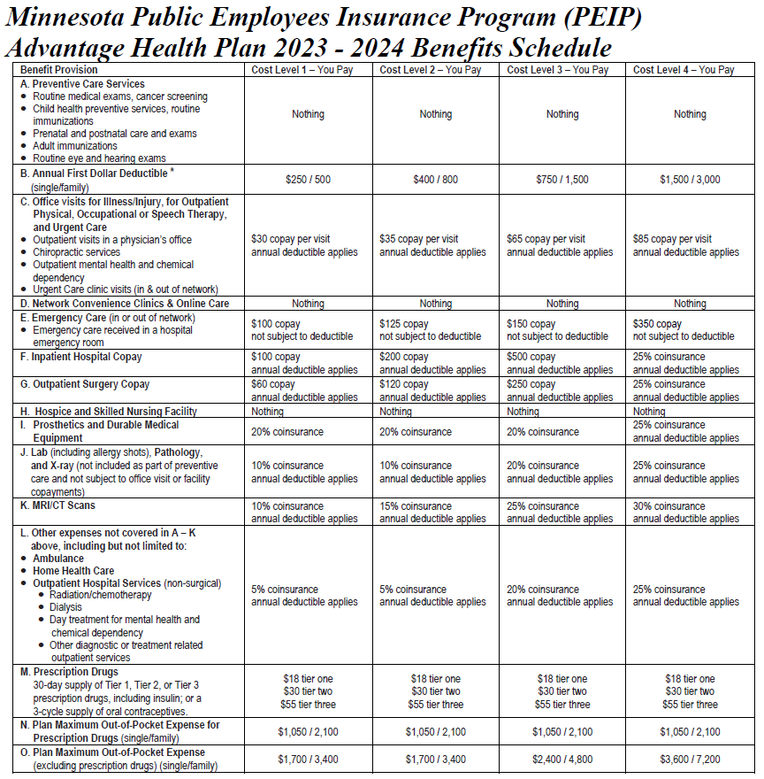
Advantage High Plan
Highest benefit level
(Highest payroll deduction)
Preventive Routine Care
covered at 100%

Slide 12
Advantage High Plan
Prescription Drugs
No Deductible
Copay per 30 day supply
Typically tiers are broken out …
Tier 1 – $18, generic & common name brand
Tier 2 – $30, name brand, some generic & specialty
Tier 3 – $55, typically specialty medications
(If medications are less than the copay, only pay the price of medication.)
Formulary tools for pricing covered meds at
www.innovomn.com
RX Out of Pocket Max - $1,050/$2,100
Mail Order for 90 day medications for 2 copays
(also available at retail CVS pharmacies)

Slide 13
Advantage High Plan
Your Deductible is based on your cost level.
CL 1 - $250/$500
CL2 – $400/$800
(Higher cost clinics, CL3 and CL4, will have higher deductibles.)
CL3 - $750/$1,500
CL4 - $1,500/$3,000
Medical Deductible is paid in full by the member first, then member is only responsible for copayments or coinsurance.
Deductibles are embedded.

Slide 14
Advantage High Plan
After the deductible has been satisfied, member only pays copayments or coinsurance for services.
Copayment is a flat dollar amount for visit or service.
Coinsurance is a % amount of the bill.
Prosthetics and Durable Medical bypass the deductible with member paying only 20% coinsurance (25% with CL4).
Network Convenience Clinics & Online Care, Hospice – no deductible, no copay

Slide 15
Advantage High Plan
Medical Out of Pocket Maximum
Once the deductible, copays and coinsurance expenses for medical total a certain level, the plan covers 100% of eligible medical expenses for the remaining contract year.
Your Medical OOP Max is based on your cost level.
CL1 - $1,700/$3,400
CL2 - $1,700/$3,400
(Higher cost clinics, CL3 and CL4, will have higher OOP max.)
CL3 - $2,400/$4,800
CL4 - $3,600/$7,200
OOP Max is embedded.

Slide 16
Value Plan

Slide 17
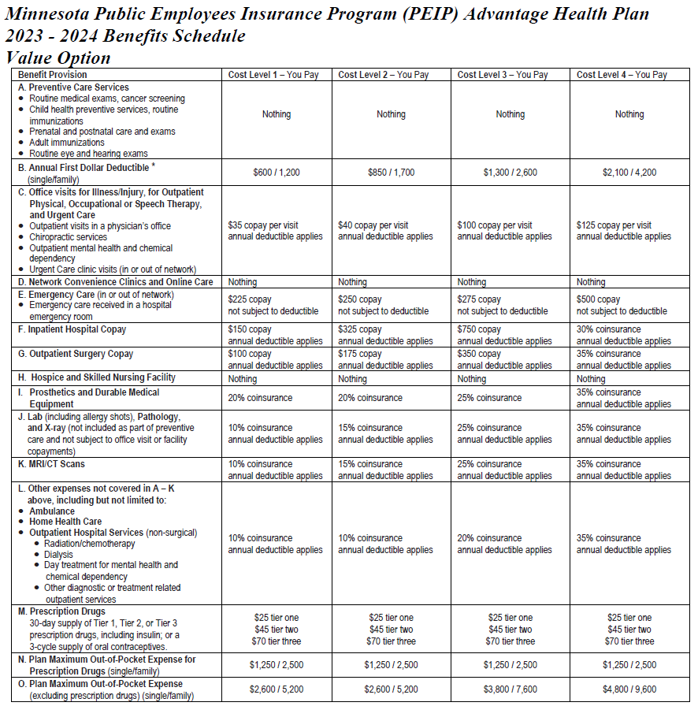
Value Plan
Mid-range benefit level
Preventive Routine Care
covered at 100%

Slide 18
Value Plan
Prescription Drugs
No Deductible
Copay per 30 day supply
Typically tiers are broken out …
Tier 1 – $25, generic & common name brand
Tier 2 – $45, name brand, some generic & specialty
Tier 3 – $70, typically specialty medications
(If medications are less than the copay, only pay the price of medication.)
Formulary tools for pricing covered meds at
www.innovomn.com
RX Out of Pocket Max - $1,250/$2,500
Mail Order for 90 day medications for 2 copays
(also available at retail CVS pharmacies)

Slide 19
Value Plan
Your Deductible is based on your cost level.
CL 1 - $600/$1,200
CL2 – $850/$1,700
(Higher cost clinics, CL3 and CL4, will have higher deductibles.)
CL3 - $1,300/$2,600
CL4 - $2,100/$4,200
Medical Deductible is paid in full by the member first, then member is only responsible for copayments or coinsurance.
Deductibles are embedded.

Slide 20
Value Plan
After the deductible has been satisfied, member only pays copayments or coinsurance for services.
Copayment is a flat dollar amount for visit or service.
Coinsurance is a % amount of the bill.
Prosthetics and Durable Medical bypass the deductible with member paying only 20% coinsurance CL1, CL2. (25% CL3, 35% CL4).
Network Convenience Clinics & Online Care, Hospice – no deductible, no copay

Slide 21
Value Plan
Medical Out of Pocket Maximum
Once the deductible, copays and coinsurance expenses for medical total a certain level, the plan covers 100% of eligible medical expenses for the remaining contract year.
Your Medical OOP Max is based on your cost level.
CL1 - $2,600/$5,200
CL2 - $2,600/$5,200
(Higher cost clinics, CL3 and CL4, will have higher OOP max.)
CL3 - $3,800/$7,600
CL4 - $4,800/$9,600
OOP Max is embedded.

Slide 22
HSA Plan

Slide 23
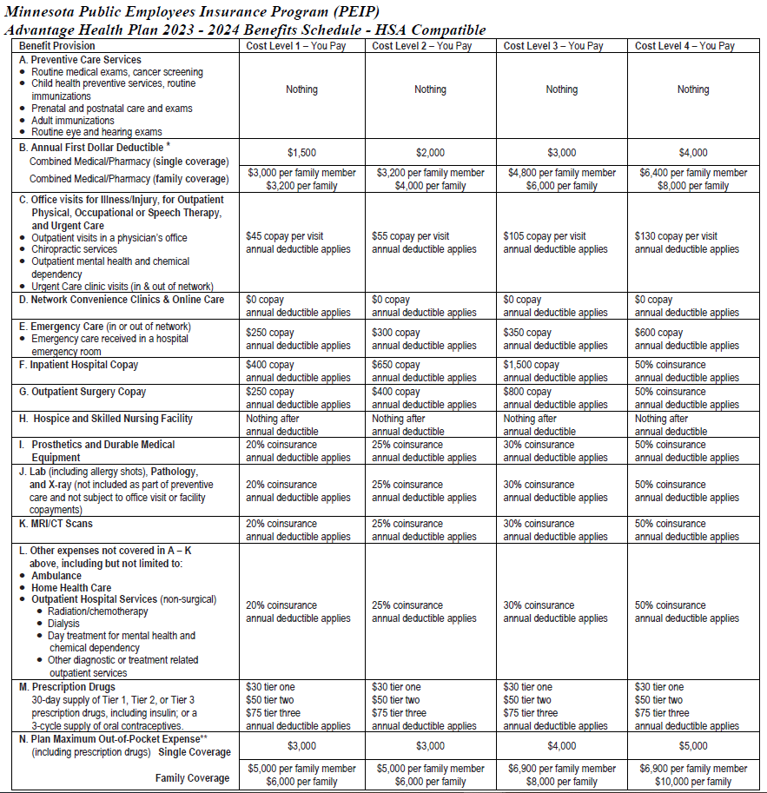
HSA Plan
High deductible, lowest payroll deduction
HSA plan meets IRS rules for QHDHP and works differently than High & Value plan:
Medical and Prescription Drugs are combined
Deductible must be satisfied before member moves into copayments or coinsurance
Preventive Routine Care
covered at 100%

Slide 24
HSA Plan
Prescription Drugs
After Deductible, Copay per 30 day supply
Typically tiers are broken out …
Tier 1 – $30, generic & common name brand
Tier 2 – $50, name brand, some generic & specialty
Tier 3 – $75, typically specialty medications
(If medications are less than the copay, only pay the price of medication.)
Formulary tools for pricing covered meds at
www.innovomn.com
Mail Order for 90 day medications for 2 copays, after deductible is met.
(also available at retail CVS pharmacies)

Slide 25
HSA Plan
Your Deductible is based on your cost level.
CL 1 - $1,500/$3,000
CL2 – $2,000/$4,000
(Higher cost clinics, CL3 and CL4, will have higher deductibles.)
CL3 - $3,000/$6,000
CL4 - $4,000/$8,000
Note: Family Coverage has an embedded individual deductible.
Deductible is paid in full by the member first for medical and prescription drugs, then member is only responsible for copayments or coinsurance.

Slide 26
HSA Plan
After the deductible has been satisfied, member only pays copayments or coinsurance for services.
Copayment is a flat dollar amount for visit or service.
Coinsurance is a % amount of the bill.

Slide 27
HSA Plan
Medical & RX Out of Pocket Maximum Combined
Once the deductible, copays and coinsurance expenses for medical and prescription drugs total a certain level, the plan covers 100% of eligible expenses for the remaining contract year.
Your Medical & RX OOP Max is based on your cost level.
CL1 - $3,000/$6,000
CL2 - $3,000/$6,000
(Higher cost clinics, CL3 and CL4, will have higher OOP max.)
CL3 - $4,000/$8,000
CL4 - $5,000/$10,000
Note: Family Coverage has an embedded individual out of pocket maximum.

Slide 28
Out of Area Coverage
(Point of Service, POS)
For members with a permanent residence outside the PEIP service area. Coverage includes students and dependents living away from home.
Members would enroll in in-network coverage choosing a PCC. In-network coverage would apply when at home. Emergency and Urgent Care, and prescription drugs are covered anywhere. If additional coverage is desired, qualified members can enroll in POS.
There is no additional premium.
POS Coverage
  Advantage High and Value – Separate $350 single/$500 family deductible. 30% coinsurance. OOP Max mirrors your in-network OOP Max.
  HSA – Separate $1,500 single/$3,000 family deductible. 30% coinsurance. OOP Max mirrors your in-network OOP Max.

Slide 29
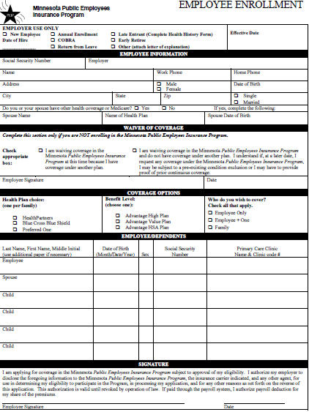
Health Enrollment Form
(if your group uses paper forms)
Complete Employee Information Section
Skip. Only complete ‘other health coverage’ section if you or
your dependents will be double covered while on PEIP.
Choose your health plan network (HP, BC, P1)
Choose your plan level (High, Value, HSA)
Choose your coverage level.
Complete information for all family members.
Be sure to include the name and PCC # for all family members.
(Match PCC # to the health plan network you choose.)
Sign and date your enrollment form.
1
1
2
2
3
3
4
4
5
5

Slide 30
Tips
Benefits are on a calendar year basis. Deductibles and out of pocket maxs will reset each January. (If your PEIP plan begins February - December 2023, your prior group coverage deductibles, RX and out of pocket expenses incurred in 2023, will be credited appropriately to PEIP for the 2023 plan year.)
Any prior referrals you received from your doctor will need to be refreshed/resubmitted at your PCC for PEIP.
Any Prescriptions (Rx) that can be filled in late December will help make the transition to a new plan go more smoothly.
To avoid delays in your enrollment, please type or print clearly on your form.
Be sure to note
the cost level and
correct PCC #
that matches your
Network Carrier
(HP, BC, P1)
when enrolling.

